Slide 1

Brain Tumor Segmentation
An Image Processing Case Study
Professor:
Guerriero Andrea
Student:
Davide Minervini

Slide 2
Introduction
CHARACTERISTICS OF BRAIN TUMORS:
Tumor Morphology: diverse morphological patterns,including irregular shapes, variable sizes, and complex boundaries.
Heterogeneous Intensity: varying signal intensities due to differences in cellularity, vascularity, and the presence of different tissue types (e.g., solid tumor tissue, necrosis, edema).
Multimodal Imaging: Involves multiple MRI sequences, each one providing different information about tumor characteristics;
Partial Volume Effect: occurs when a voxel contains a mixture of different tissue types due to the limited resolution of medical images. This effect can lead to misclassifications of the tumor boundaries;
Inter- and Intra-Tumor Heterogeneity: This heterogeneity arises from differences in tumor subtypes, genetic variations and treatment effects.
Our Goal is to acknowledge this characteristics and automate the segmentation process to delineate the tumor boundaries.

Slide 3
Dataset Description
The BRATS2020 dataset is composed by a collection of preoperative MRI scans acquired from patients diagnosed with gliomas. There are four types of scans:
T1-Weighted (T1) Scans: Cerebrospinal fluid (CSF) appears dark, while gray matter and white matter have different intensities. T1 scans help identify brain structures and provide information about tissue composition;
T1-Weighted Contrast-Enhanced (T1CE) Scans: Use of a contrast agent that accumulates in areas with increased vascularity, such as tumor regions, enhancing their visibility in the image. T1CE scans provide valuable information about tumor location, extent, and enhancement characteristics;
T2-Weighted (T2) Scan: CSF appears bright, while gray matter and white matter have different intensities. T2 scans help visualize abnormalities in brain tissue;
Fluid-Attenuated Inversion Recovery (FLAIR) Scan: T2-weighted images with the suppression of signal from CSF, that allows better visualization of pathological changes. FLAIR scans are particularly useful for detecting lesions surrounded by edema.
Additionally, the dataset provides ground truth masks for confrontation and evaluation of results.

Slide 4
Pre-Processing Pipeline
Z-Score Normalization;
Bias Field Correction;
Gaussian Smoothing Noise Reduction.

Slide 5
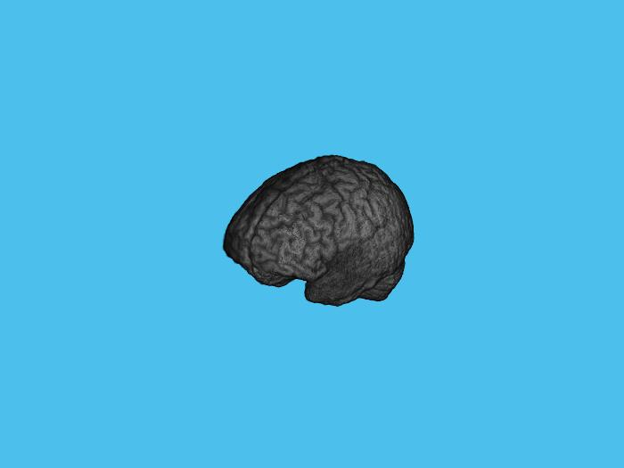
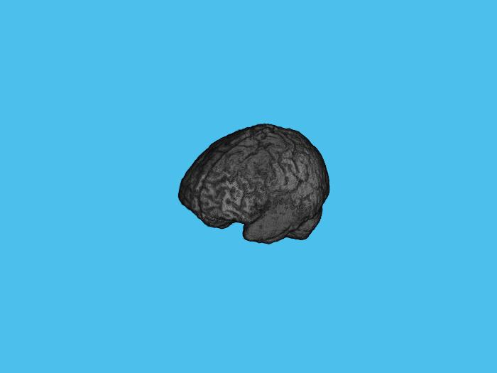
Z-Score Normalization
Aims to standardize the intensity values across the dataset, transforming the pixel intensities of the MRI images to the mean and standard deviation of the entire dataset;
Each pixel intensity in the images is transformed by subtracting the mean and dividing by the standard deviation. This transformation results in a distribution of intensity values centered around zero, with a standard deviation of one;
The z-score normalization enhances the consistency and facilitates the subsequent processing and analysis steps.

Slide 6
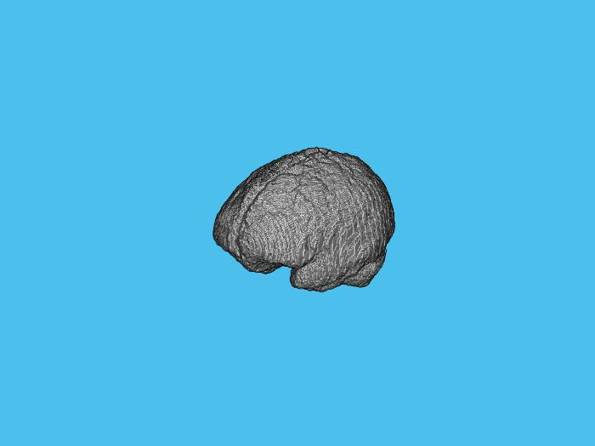
Bias Field Correction
Bias Field Correction addresses the presence of intensity variations caused by a phenomenon known as the bias field or intensity inhomogeneity. This refers to a smoothly varying non-uniformity in the image intensities, which can result from various sources;
Once the bias field is estimated, it is then used to correct the image by dividing the original intensities by the estimated bias field. This division operation equalizes the intensity variations, effectively removing the influence of the bias field and improving the overall image quality.

Slide 7
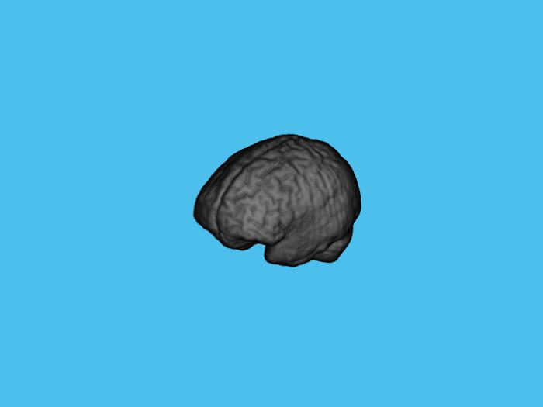
Gaussian Smoothing Noise Reduction
Helps to mitigate the effects of noise by applying a spatially adaptive low-pass filtering operation;
The filter operates by averaging the intensities of neighboring pixels, with the weights determined by the Gaussian kernel;
The key parameter in Gaussian Smoothing is the standard deviation (σ) of the Gaussian function. It controls the width of the smoothing kernel and determines the degree of smoothing applied to the image. A larger standard deviation leads to a broader kernel and stronger smoothing effect, while a smaller standard deviation preserves finer details at the cost of less noise reduction.

Slide 8
Thresholding-based Method
This method relies on setting intensity thresholds to separate tumor regions from the background and healthy brain tissue. The underlying assumption is that the intensity values of tumor regions differ significantly from those of healthy tissue;
In this method, the first step is to select appropriate threshold values that can effectively differentiate tumor regions. These thresholds can be determined manually based on domain knowledge or automatically through various thresholding algorithms.
By iteratively evaluating different threshold values and measuring their performance using the Jaccard index, the algorithm identifies the best threshold value that maximizes the similarity between the segmented tumor mask and the ground truth.
Pixels with intensity values above the upper threshold are classified as tumor regions, while those below the lower threshold are considered healthy brain tissue. The region between the upper and lower thresholds may represent the peritumoral edema.

Slide 9
Thresholding-based Method
The determination of the thresholding value can be summed up in three main steps:
Thresholding Using a Range of Values: A range of threshold values is defined, ranging from 0.01 to 0.99 with a step size of 0.01. These values represent the intensity thresholds for classifying tumor regions. Each threshold value will be evaluated to find the optimal threshold for segmentation;
Jaccard Index Calculation: For each threshold value, a binary mask is created by thresholding the normalized image. The binary mask separates potential tumor regions from the background and healthy brain tissue. To evaluate the quality of the segmentation, the Jaccard index is calculated. It measures the similarity between the segmented tumor mask and the ground truth mask;
Threshold Selection: The threshold value that yields the highest Jaccard index is identified as the best threshold for tumor segmentation. This is determined by finding the maximum value in the Jaccard index array and retrieving the corresponding threshold value.

Slide 10
Thresholding-based Method
Advantages:
Simplicity;
Computational Efficiency;
Ease of implementation;
Provides good results when tumors exhibit clear intensity differences from healthy tissue;
Doesn't rely on complex algorithms or training data.
Disadvantages:
Struggles with tumors that have overlapping intensity values with healthy tissue or tumors with significant intensity variations;
Determining optimal threshold values can be challenging, as they may vary across different tumor types and imaging modalities.

Slide 11
Evaluation Metrics
Dice Similarity Index;
Jaccard Similarity Index;
Volume Similarity Index

Slide 12
Dice Similarity Index
The Dice Similarity Index (DSI), also known as the Dice coefficient or F1 score, is a common evaluation metric used to assess the similarity between two sets of segmentations;
The DSI compares the overlap between the segmented tumor region and the reference tumor region. It quantifies the proportion of correctly classified tumor voxels (true positives) in relation to the total number of tumor voxels present in both the predicted and ground truth segmentations;
DSI = (2 * TP) / (2 * TP + FP + FN)
DSI = 1 => Complete overlap between the predicted and ground truth segmentations.
DSI = 0 => No overlap between the segmentations,
indicating a complete mismatch between the predicted and ground truth tumor regions.

Slide 13
Jaccard Similarity Index
The Jaccard Similarity Index (JSI), also known as the Jaccard coefficient or Intersection over Union (IoU), provides a measure of the overlap between the predicted tumor region and the ground truth tumor region.
The JSI compares the intersection (common area) of the segmented tumor region and the reference tumor region with their union (total area). It quantifies the proportion of correctly classified tumor voxels (true positives) in relation to the total number of tumor voxels present in both the predicted and ground truth segmentations.
JSI = TP / (TP + FP + FN)
JSI = 1 => Complete overlap between the predicted and ground truth segmentations.
JSI = 0 => No overlap between the segmentations,
indicating a complete mismatch between the predicted and ground truth tumor regions.

Slide 14
Volume Similarity Index
The VSI compares the volume of the intersection (common area) of the segmented tumor region and the reference tumor region with the average volume of the predicted and ground truth tumor regions. It provides a measure of how well the predicted volume matches the ground truth volume.
VSI = (2 * |Vp ∩ Vg|) / (|Vp| + |Vg|)
Where:
|Vp ∩ Vg| represents the volume of the intersection between the predicted tumor region (Vp) and the ground truth tumor region (Vg);
|Vp| represents the volume of the predicted tumor region;
|Vg| represents the volume of the ground truth tumor region.
VSI = 1 => Predicted tumor volume perfectly matches the ground truth tumor volume;
VSI = 0 => No overlap between the predicted and ground truth tumor volumes,

Slide 15
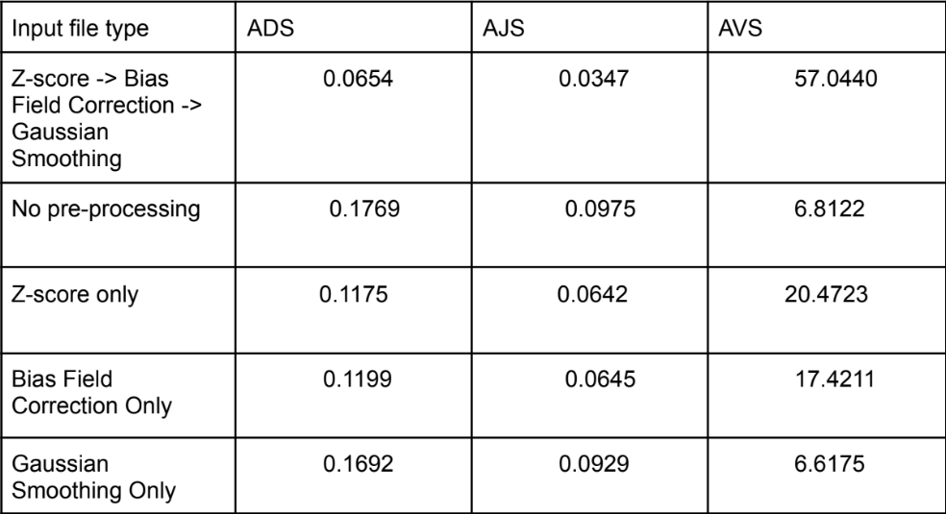
Results
The implementation of the thresholding-based segmentation method gave the following results (on t1 scan):

Slide 16

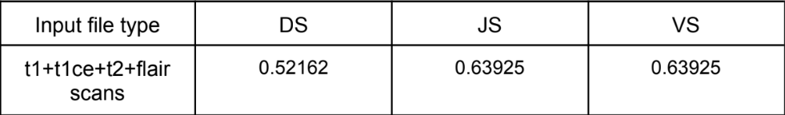
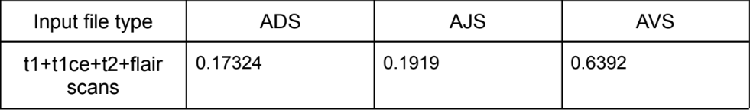
Results
Applying a combined threshold-based method on a single scan, the results are:
Applying the same combined segmentation process to all the dataset, the results are:

Slide 17
Conclusions
The results are highly subject to fluctuations due to the nature of the dataset (including the type of scan we are considering), to pre-processing methods used and segmentation method's parameter tuning;
To overcome these aspects, the implemetation of an ML-based approach can be taken into account. In this way we can automatize and optimize the process of parameter setting (from the pre-processing phase to the segmentation algorithm) in a data-driven way, tailoring parameters for the single scan we are taking into account;
Particularly, the different characteristics of the scan types for a single patient can require different pre-processing methods (even several of them for the same file) that we could evaluate mid-process;
This approach can be extended to the segmentation methods involved, giving more segmentation options according to the data the file itself gives us;
Overall, these possible improvements need to be trained and tested, requiring more computational resources and different programming languages to significantly reduce execution times.

